Slide 1
Road To Civil War 1815-1861
Sectionalism-loyalty to state/section of nation-North,South and West had their own priorities $$$$ Tariffs
States Rights vs. Federal Supremacy-
Do states have right to nullify/not follow national laws
Territorial Expansion-with each new state the question arose Would SLAVERY be allowed in the new territories????

Slide 2
Tariffs

Slide 3
The Great Compromiser

Slide 4
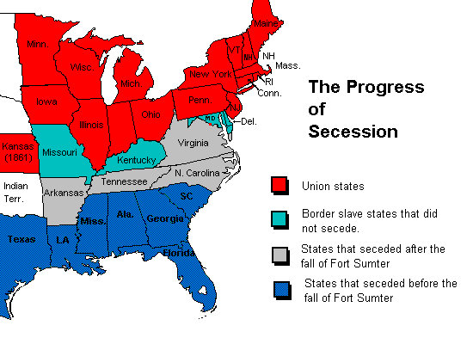

Slide 5
Manifest Destiny
Many in US felt it was God Given Right to Expand West to Pacific Ocean
Problem - Should New Areas Allow SLAVERY?
Areas gained by-
Louisiana Purchase
Texas Annexation
Mexican American War

Slide 7
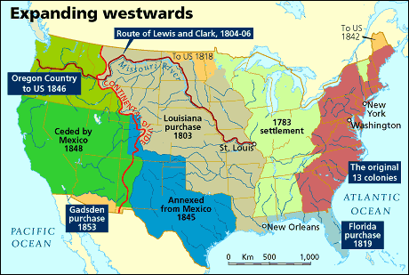

Slide 8
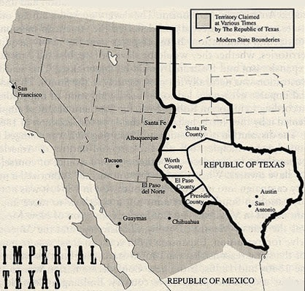

Slide 10
Missouri Compromise

Slide 11
New Territories and Slavery
Abolitionists-people who wanted slavery abolished-especially wanted slavery outlawed in new territories
Slavery was an economic$$ and social way of life in the South
Slave States feared too many Free State representatives in Congress would lead to an end to slavery and end their way of life.

Slide 12
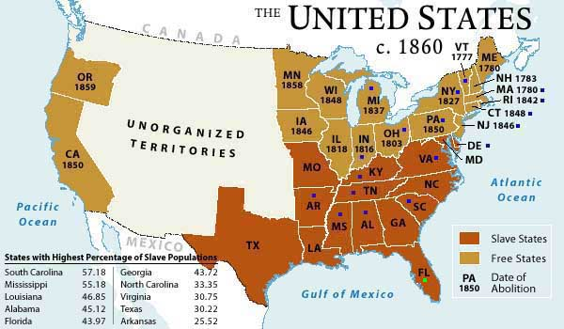

Slide 13
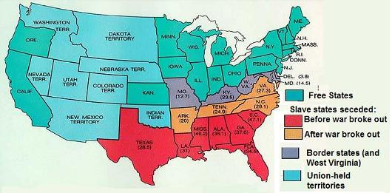

Slide 14
Abolitionists

Slide 15
Abolitionists

Slide 16
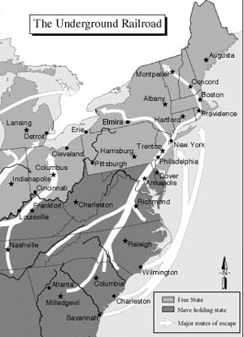

Slide 17
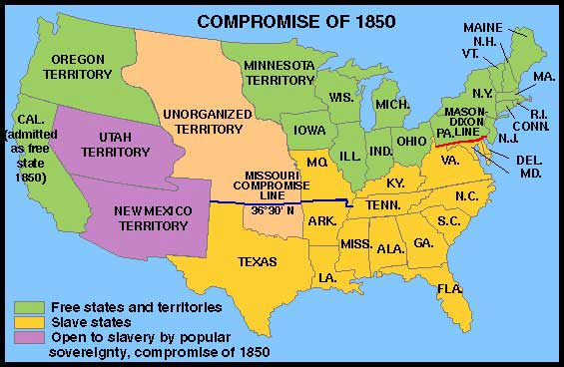

Slide 18
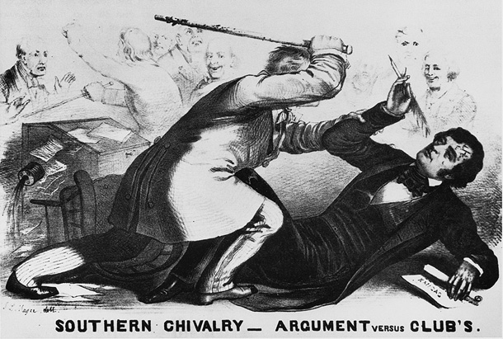

Slide 19
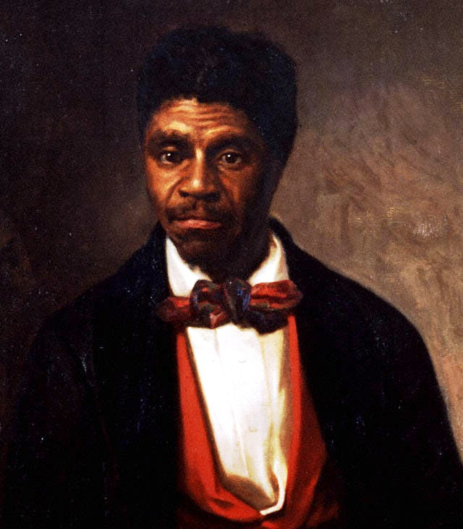

Slide 20
John Brown’s Raid
Planned to lead a slave revolt by arming slaves w/guns stolen from the armory in Harpers Ferry, Va.
Oct. 1859-Brown + 22 others raid the armory and take the guns.
The Marines put down the rebellion. Brown and four others are hanged.

Slide 21
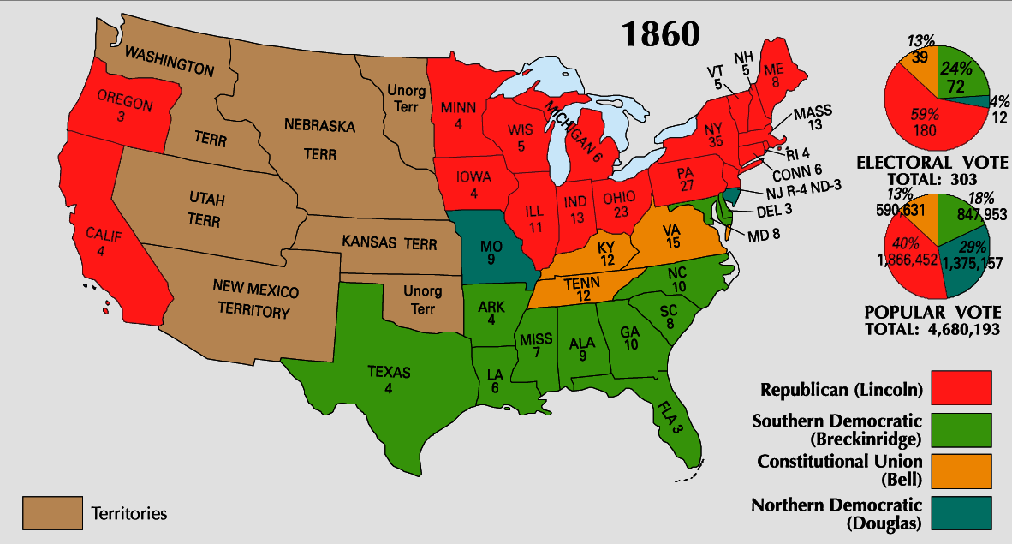

Slide 22
Lincoln’s Election was the immediate cause of the South Seceeding

Slide 23
Tariff,Nullify,Secede,Henry Clay
John C. Calhoun, Manifest Destiny, TexasAnnexation,MexicanCession,Oregon, Florida,TreatyofGuadalupeHidalgo, MissouriCompromise,Abolitionist, HarrietBeecherStowe,WilliamGarrison, FrederickDouglas,HarrietTubman, UndergroundRR,Comp.1850, PopSov.,KansasNebAct,BleedingKansas, SumnerBrooks,DredScott,FortSumter

